Slide 1
Raspberry Pi Emotion detection for Digital Signage
Frank Jiang

Slide 2

Project concept
Digital signage is an luxury advertising media.
Yet one-way broadcasting can't get the viewers' feedback in real time.
Use Raspberry Pi for detecting the passing-by viewers' emotion feedback to evaluate the advertising effectiveness.

Slide 3

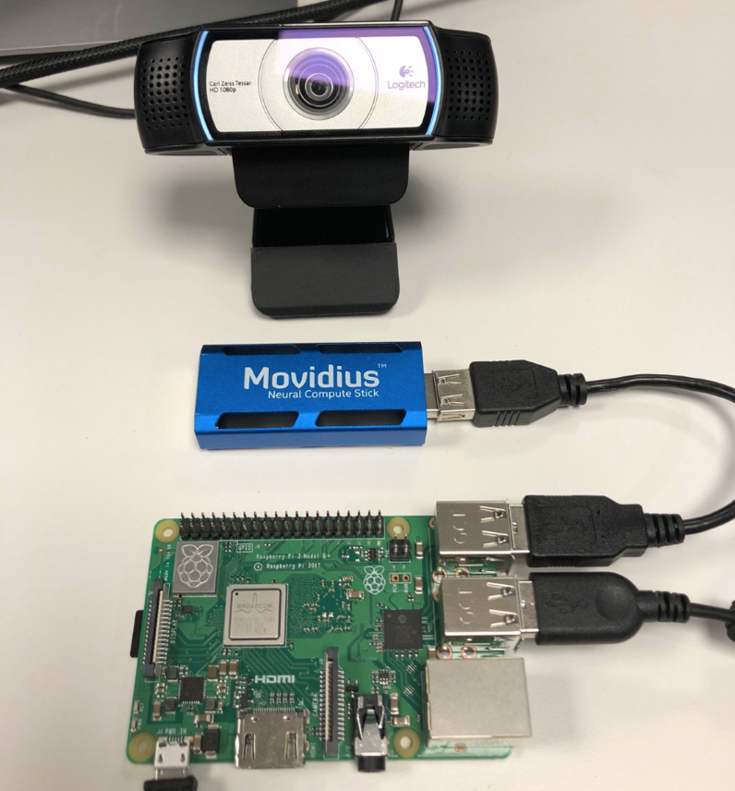


System Diagram
Viewer emotion
Digital advertizing data

Slide 4
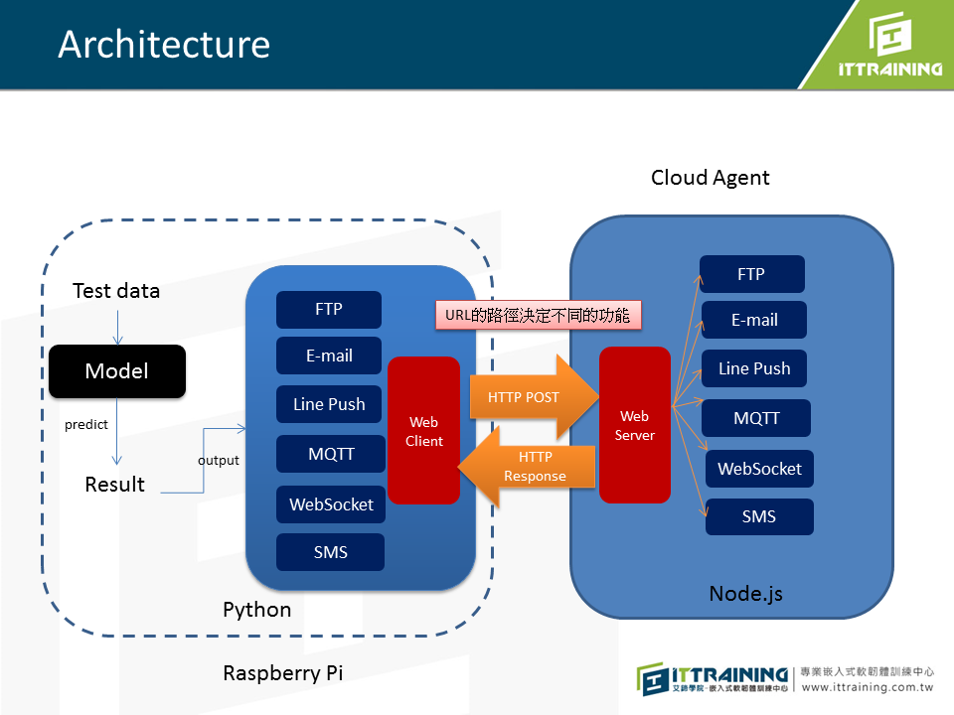
System Diagram

